Slide 1


PhD. Truong Toan Thinh
PhD. Nguyen Thanh An
M. Tran Ngoc Dat Thanh
SPECIAL THANKS

Slide 2
PhD. Truong Toan Thinh
PhD. Nguyen Thanh An
M. Tran Ngoc Dat Thanh
SPECIAL THANKS
TABLE OF CONTENTS
ABOUT US
GENERAL INTRODUTION
PRODUCT INTRODUTION
ABOUT SOURCE CODE
REFERENCE

Slide 3

TABLE OF CONTENTS
ABOUT US
GENERAL INTRODUTION
PRODUCT INTRODUTION
ABOUT SOURCE CODE
REFERENCE
PhD. Truong Toan Thinh
PhD. Nguyen Thanh An
M. Tran Ngoc Dat Thanh
SPECIAL THANKS

Slide 4

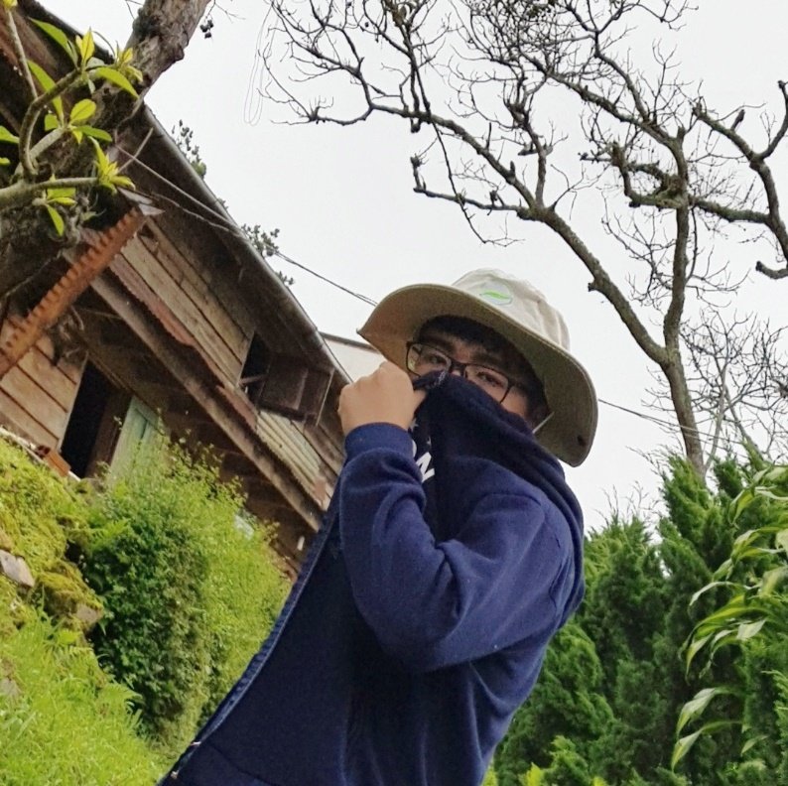
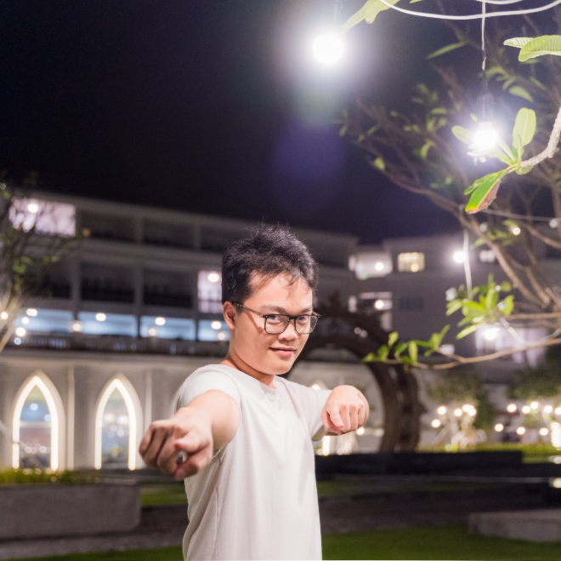
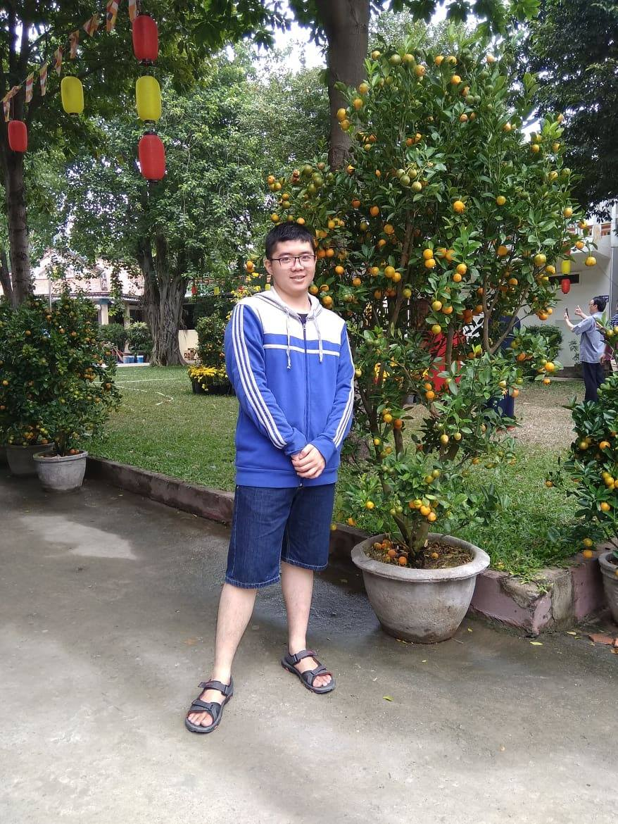
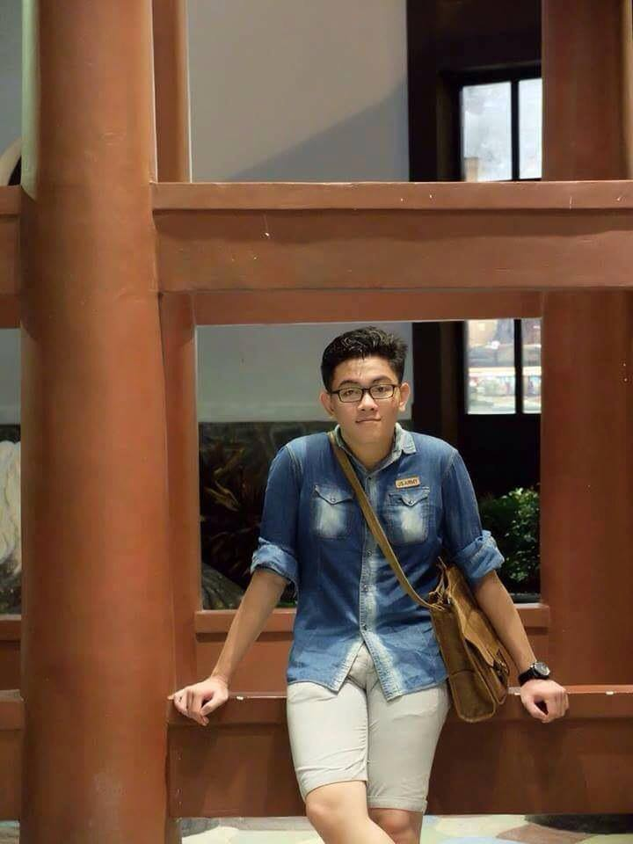
Nguyen Thanh Tinh 19127292
 | Tran Xuan Son 19127321
Pham Anh Tuan 19127084
 | Ho Huu Vien 18127251
ABOUT US

Slide 5






GENERAL INTRODUTION

Slide 6
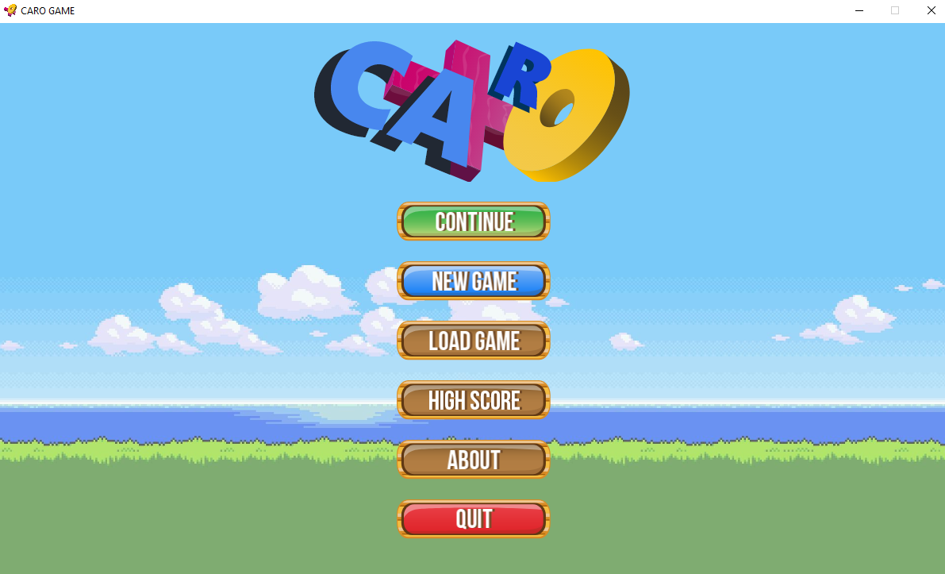
PRODUCT INTRODUTION

Slide 7
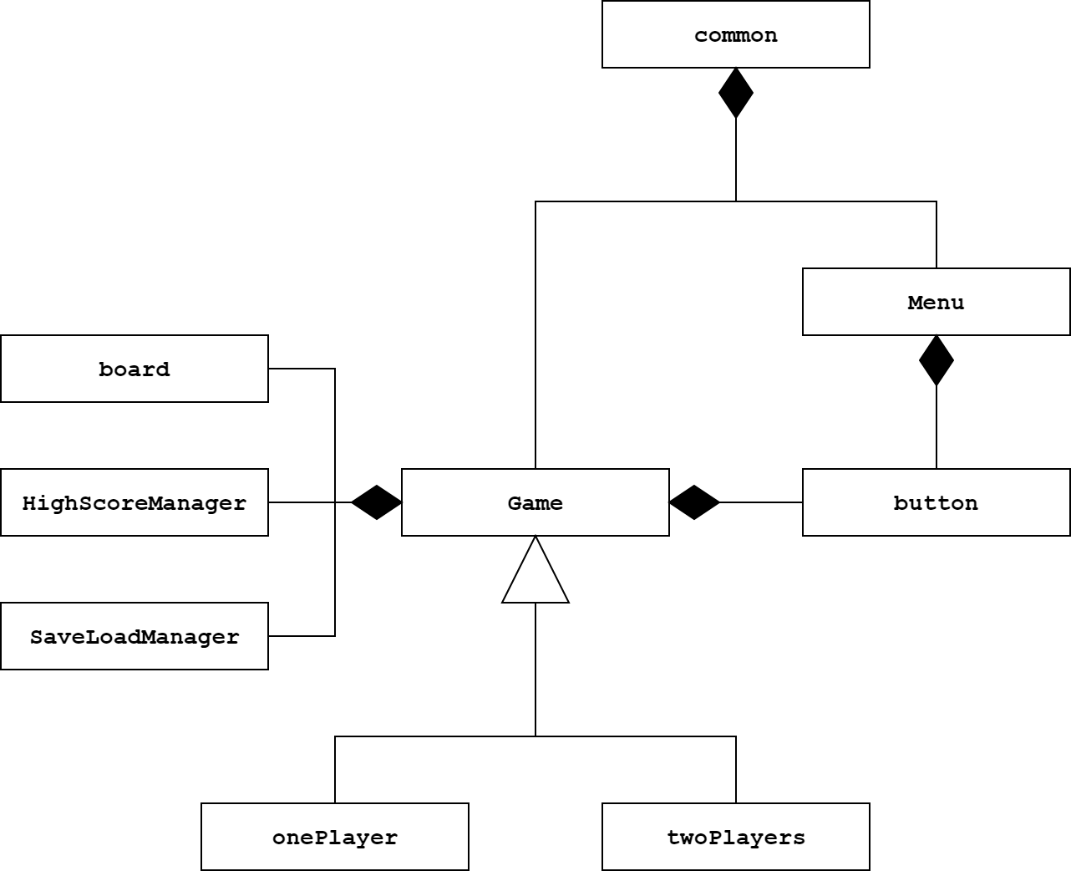
ABOUT SOURCE CODE

Slide 8
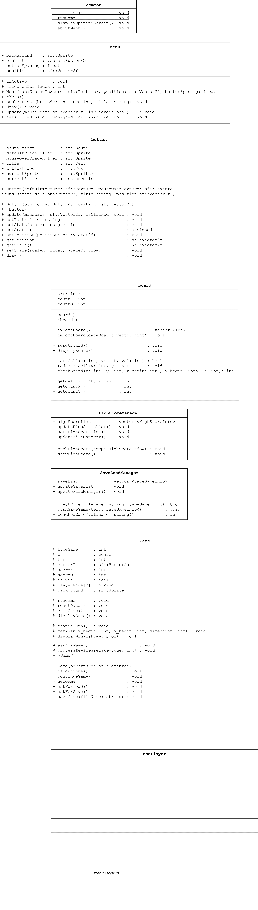
ABOUT SOURCE CODE

Slide 9
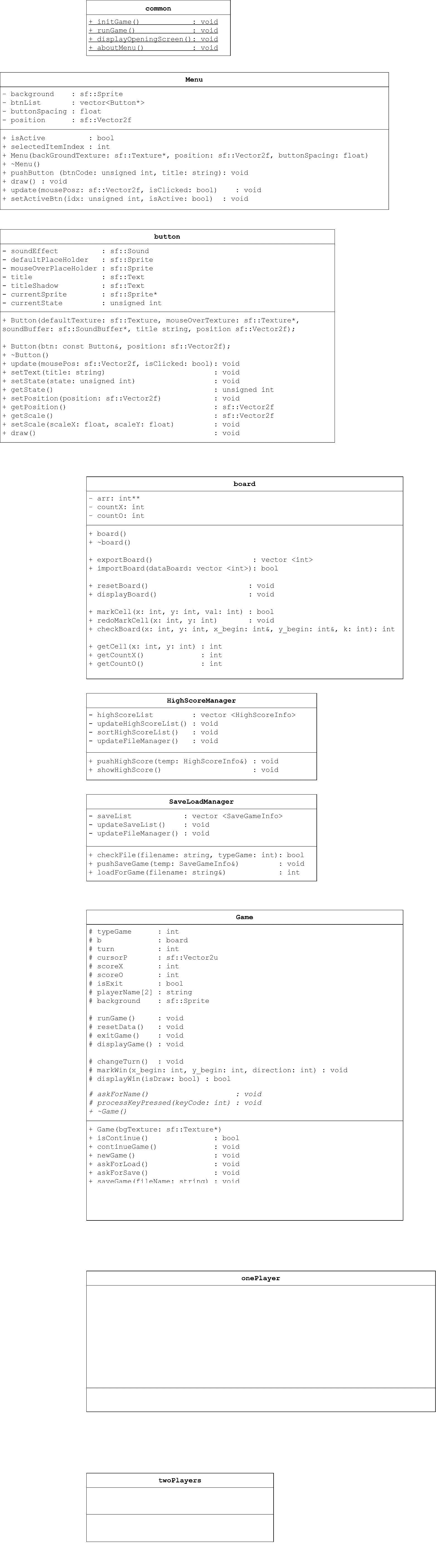
ABOUT SOURCE CODE

Slide 10
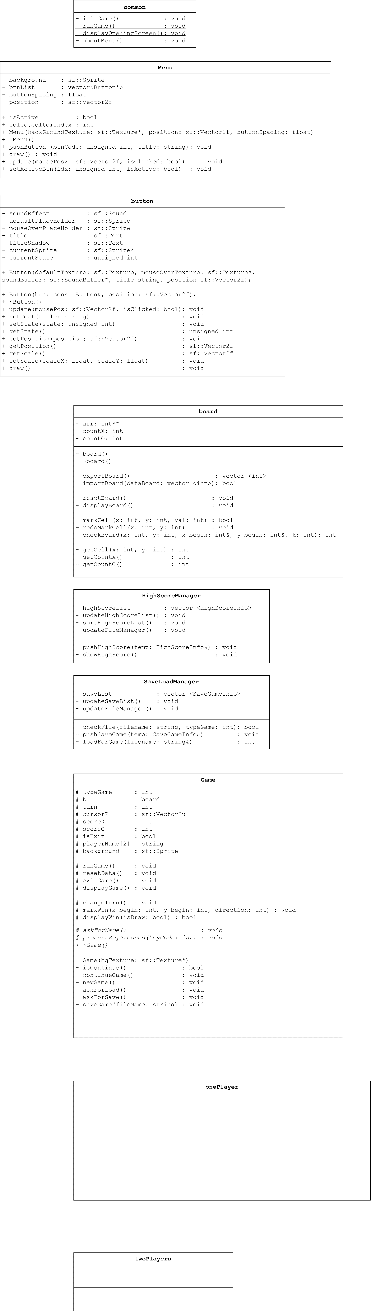
ABOUT SOURCE CODE

Slide 11

ABOUT SOURCE CODE

Slide 12
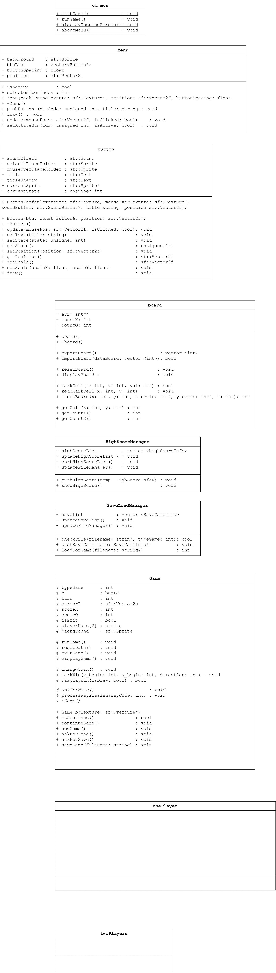
ABOUT SOURCE CODE

Slide 13
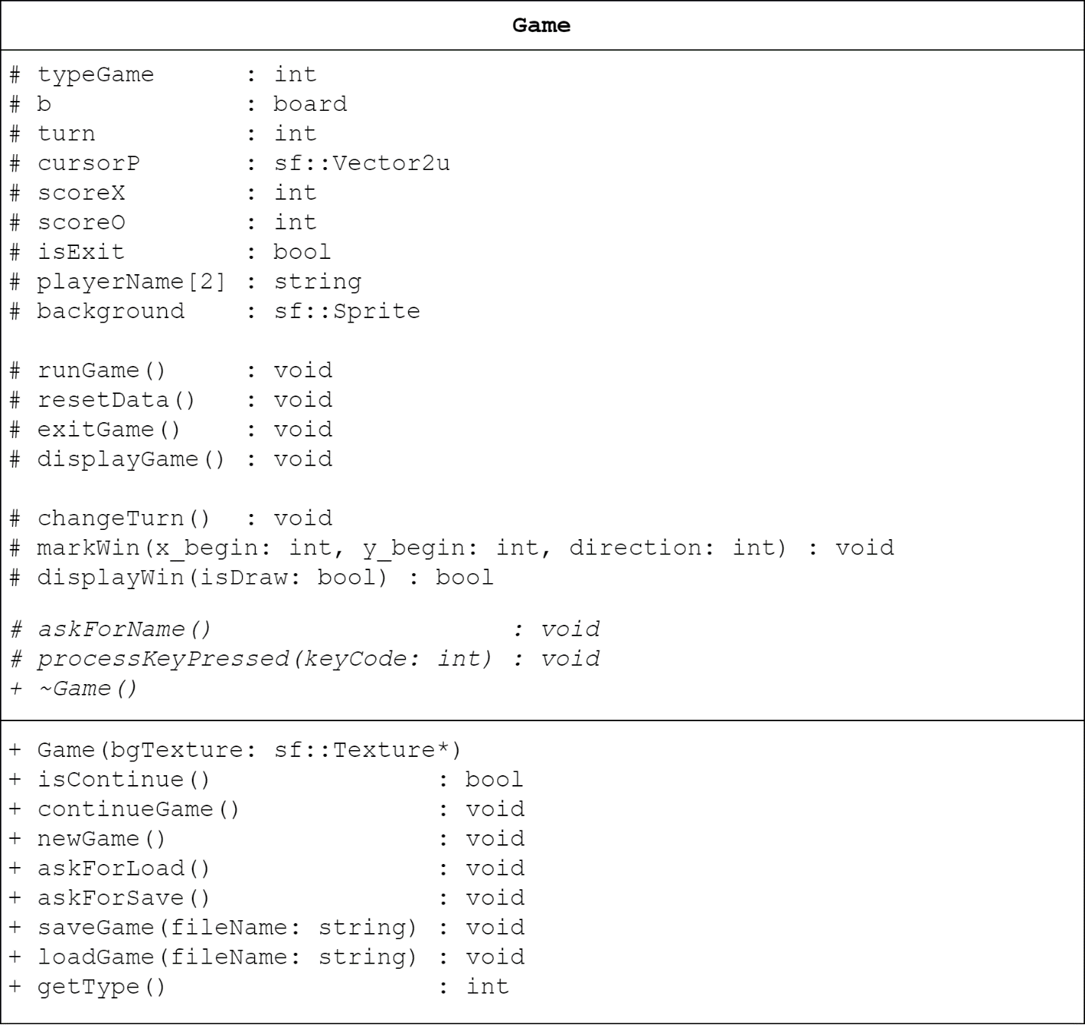
ABOUT SOURCE CODE

Slide 14
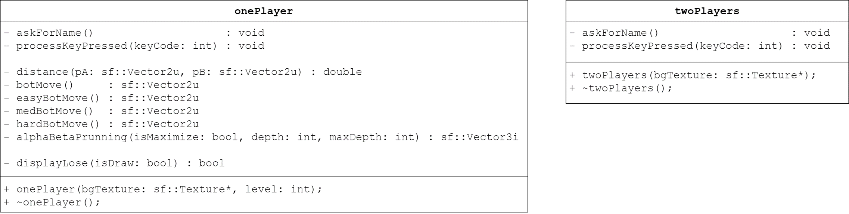
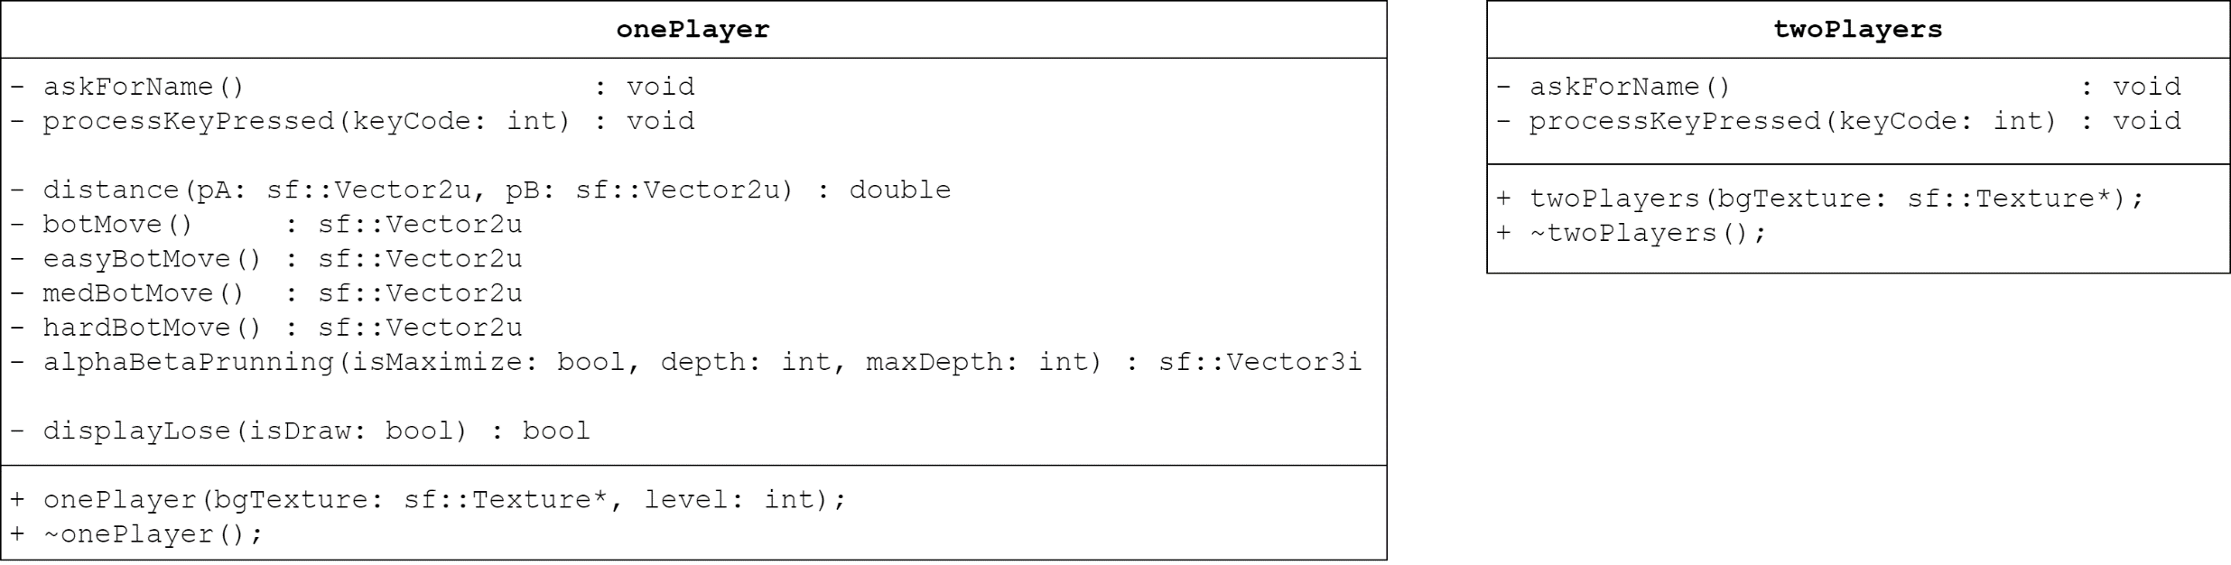
ABOUT SOURCE CODE

Slide 15
void Game::Process Key Pressed (Key Code)
{
…
If Key Code is ‘L’: Call Ask For Save;
If Key Code is ‘T’: Call Ask For Load;
…
}
ABOUT SOURCE CODE

Slide 16
void Game::Ask For Save ()
{
Step 1: Get players’ file name string
Step 2: Check for Validity of the string
If Invalid: Back to Step 1;
Else Head to Step 3;
Step 3: Create a struct of all game’s data
Step 4: Write the struct into a file with BINARY format
Step 5: Save some info into SaveLoadManager class, so that the game could manage and keep save files original.
Step 6: Announce “Sucessful”
}
ABOUT SOURCE CODE

Slide 17
void Game::Ask For Load ()
{
Step 1: Get players’ file name string
Step 2: Check for Validity of the string
If Invalid: Back to Step 1;
Else Head to Step 3;
Step 3: Create a struct to store all game’s data
Step 4: Read the file with filename entered by players into the struct in BINARY format
Step 5: Coping data from the struct to game’s data
Step 6: Announce “Sucessful”
}
ABOUT SOURCE CODE

Slide 18
int board::Check Board (int x and y coordinate)
{
Step 1: If arr[x][y] equals zero, it means no move there, return 0 (No result)
Step 2: Check vertical
If there are 5 consecutive moves have the same value, return 1 (Vertical winning moves)
Else go to Step 3.
Step 3: Check horizon
If there are 5 consecutive moves have the same value, return 1 (Vertical winning moves)
Else go to Step 4.
Step 4: Check diagonal
If there are 5 consecutive moves have the same value, return 1 (Vertical winning moves)
Else go to Step 5.
Step 5: Check anti-diagonal
If there are 5 consecutive moves have the same value, return 1 (Vertical winning moves)
Else go to Step 6.
Step 6: return 0 because there are no winning moves.
}
ABOUT SOURCE CODE

Slide 19
void Game::Process Key Pressed (Key Code)
{
…
If Key Code is ‘Enter’:
{
Step 1: Mark the board
Step 2: If Check Board equals TRUE, display Win/Lose Animation!
Else head to Step 3;
Step 3: If Board is full of move, display DRAW!
Else head to Step 4;
Step 4: Change Turn (in twoPlayers)
Step 5: Back to the game
}
…
}
ABOUT SOURCE CODE

Slide 20
class board { … int countX; // Count moves of X int countO; // Count moves of O … } | class Game { … int scoreX; // Score of X int scoreO; // Score of O … }
ABOUT SOURCE CODE

Slide 21
// Main Menu
mainMenu.pushButton(2, "CONTINUE");
mainMenu.pushButton(0, "NEW GAME");
mainMenu.pushButton(1, "LOAD GAME");
mainMenu.pushButton(1, "HIGH SCORE");
mainMenu.pushButton(1, "ABOUT");
mainMenu.pushButton(3, "QUIT");
// New Game Menu
newGameMenu.pushButton(2, "SINGLE PLAYER");
newGameMenu.pushButton(0, "TWO PLAYERS");
// Bot Choosing Menu
botMenu.pushButton(2, "EASY");
botMenu.pushButton(4, "MEDIUM");
botMenu.pushButton(3, "HARD");
ABOUT SOURCE CODE

Slide 22
Vector2u onePlayer::botMove()
// Return a Vector2u (Vector has 2 unsigned integers) with x and y, to allocate where the BOT needs to hit.
{
If Game’s mode is Easy
Return easyBotMove();
If Game’s mode is Medium
Return medBotMove();
Return hardBotMove();
}
ABOUT SOURCE CODE

Slide 23
Vector2u onePlayer::easyBotMove()
// Random somewhere nearly player’s cell
{
Step 1: Init vector of answer
Step 2: Browse all the Board
If that cell is not hitted
{
If it’s closer, delete old vector and push the new one into vector answer.
If the distances are equal,
Push that cell into vector answer.
}
Step 3: return any value in vector answer
}
ABOUT SOURCE CODE

Slide 24
Vector2u onePlayer::mediumBotMove()
// Greedy Algorithm
{
Step 1: k = 4 (k is priority, equals how many consecutive moves has the same value)
Step 2: If k >= 2, head to Step 3;
Else go to Step 5;
Step 3: Browse all cell that are hitted
If that cell has k – consecutive moves and not to be blocked at both head and tail, Return that cell!
If that cell has k – consecutive moves and not to be blocked at head or tail, Return that cell!
Step 4: Decrease k. Back to Step 2;
Step 5: No cell is return? Return easyBotMove()
}
ABOUT SOURCE CODE

Slide 25
Vector2u onePlayer::hardBotMove()
// Alpha – Beta Prunning
{
Step 1: Get answer from alphaBetaPrunning(…)
Step 2: Take x and y coordinate out, ignore z
(z is score of move found by alphaBetaPrunning())
Step 3: Return answer
}
Vector3i onePlayer::alphaBetaPrunning
(bool isMaximize, int depth, int maxDepth)
// isMaximize show that step is Find Max, or Find Min
// depth : depth of DFS, maxDepth : maximum of DFS
{
Step 1: Browse all cells that are NOT hitted
Step 2: Try to mark that cell
Step 3: Find point of that cell
(point of cell equals how many consecutive moves has the same value, and it’s stored in variable name z)
Step 4: //Prunning
If that cell has no point, ignore it and go to Step 7;
Else head to Step 5;
Step 5: Find curseMove by call a cursed function
alphaBetaPruning(!isMaximize, depth + 1, maxDepth);
Step 6: //Minimax
If we are maximizing, choose minimum value between currentMove.z and cursedMove.z, or opposite.
Store suitable value into currentMove (tempMove).
Step 7: Redo marking that cell. If there’re unchecked cells left, back to Step 1 to continue browsing
Step 8: //Minimax
If the moveVector is not empty
Return the cell with Maximum z point if we are Maximize,
Or Return the cell with Minimum z point instead!
Step 9: If there’s no move found by AlphaBetaPruning()
Return medBotMove().
}
ABOUT SOURCE CODE

Slide 26
CaroProject_OOP.pdf: PhD.Truong Toan Thinh, CARO Game GUILDLINE
Main Menu Music:
https://youtu.be/3XH-FOSseek
Game Music:
https://youtu.be/MiUjLJJligs
SFML 2.5 Tutorial:
https://www.sfml-dev.org/tutorials/2.5/
Hướng dẫn lấy Date và Time trong C++:
https://topdev.vn/blog/date-va-time-trong-c/
Giải thuật cắt tỉa Alpha-Beta
www.stdio.vn/giai-thuat-lap-trinh/giai-thuat-cat-tia-alpha-beta-Wu7F1
Giải thuật tìm kiếm MiniMax
www.stdio.vn/giai-thuat-lap-trinh/giai-thuat-tim-kiem-minimax-s1EVnH
REFERENCE

Slide 27


